Slide 1
United States and its Dependency on Critical Minerals - 2022

Slide 2
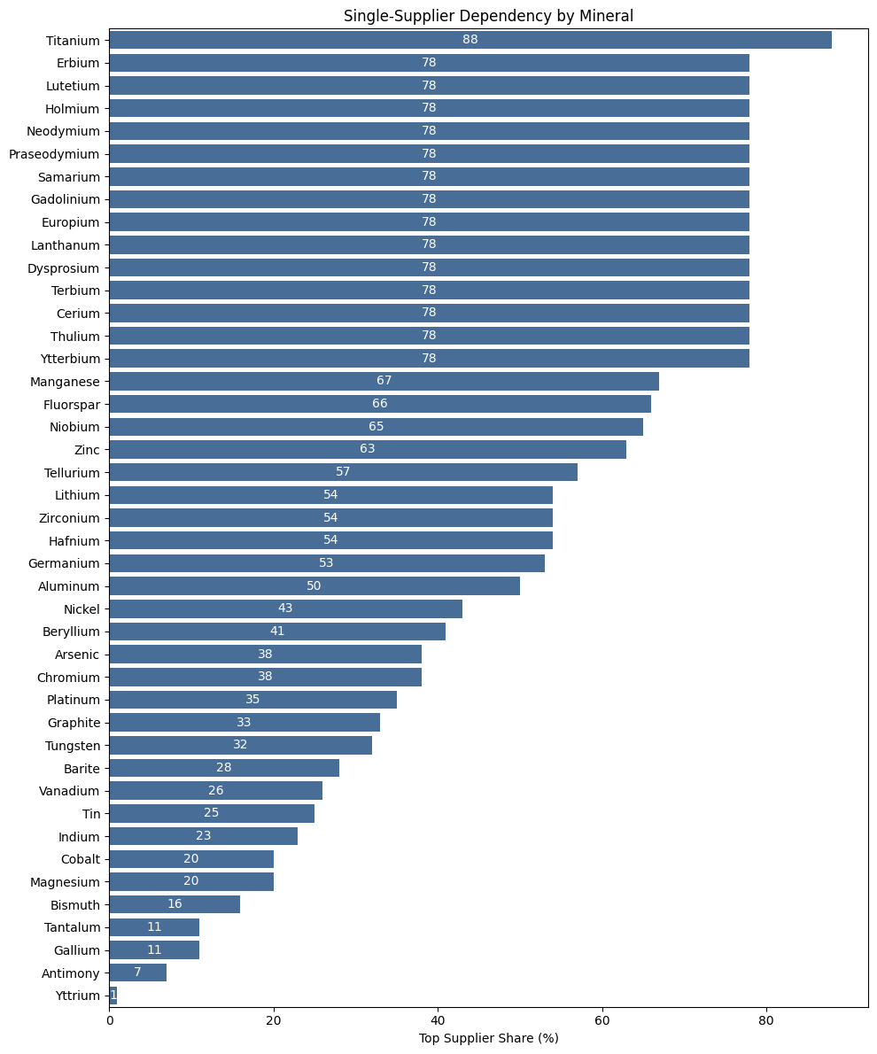
The United States imports many minerals from around the world and relies on both ally nations and geopolitically contentious countries.
- At the top of this list is titanium. Approximately 95% of titanium is consumed in the form of titanium dioxide (TiO₂), a white pigment widely used in paints, paper, and plastics.

Slide 3
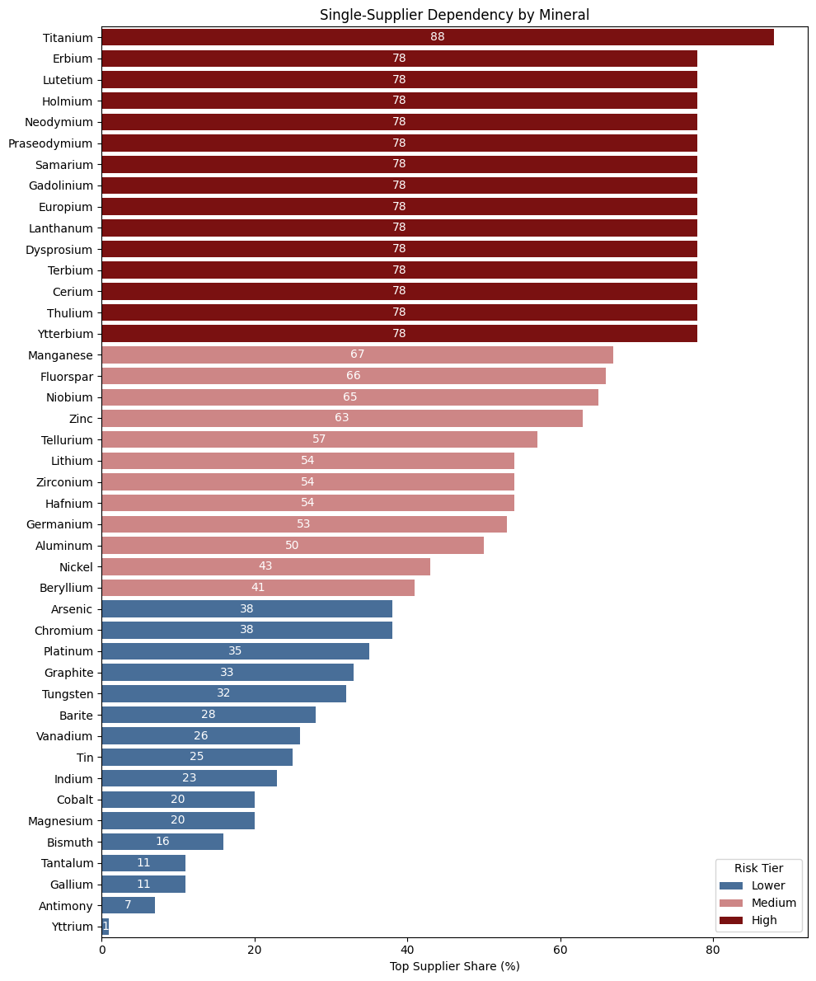
Many critical minerals have extreme single-supplier concentration
- A large cluster of rare earth elements sit around ~78% top supplier share.
- That means roughly three-quarters of U.S. imports for each of those minerals come from one country.
- This is classic single-point-of-failure risk, even before geopolitics enters the picture.

Slide 4
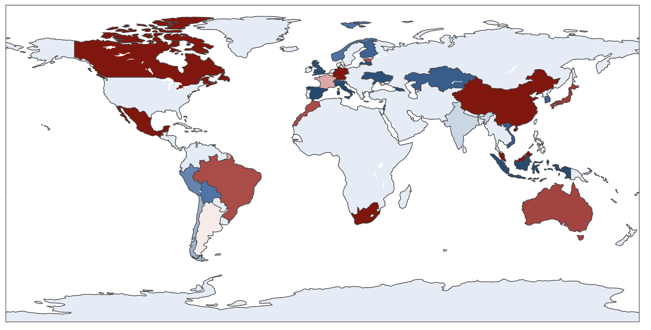
Here we see that the United States sources critical minerals from around the world, with particularly strong reliance on neighboring countries such as Canada and Mexico.

Slide 5
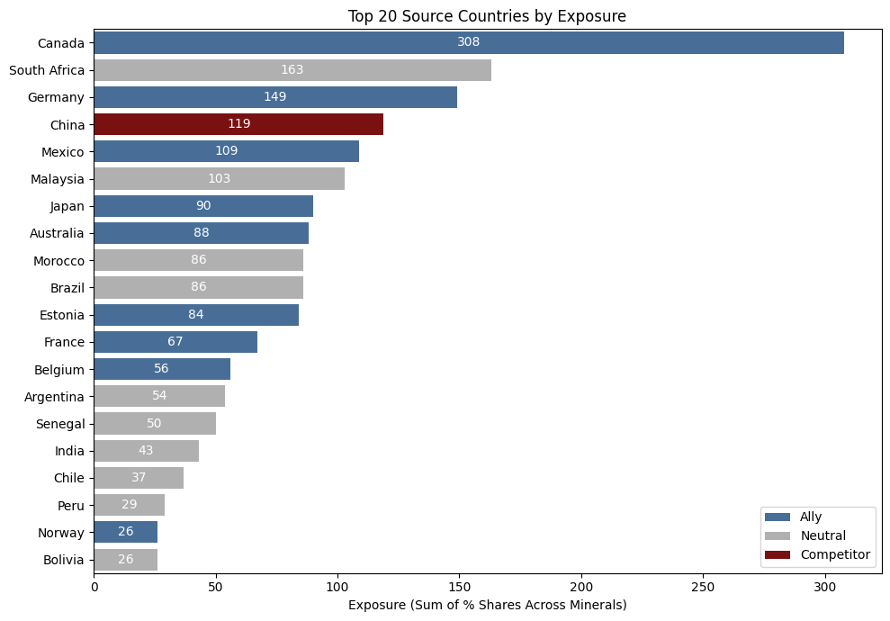
Top 20 source countries by overall exposure across U.S. critical mineral imports.
- Exposure reflects the summed import shares across all minerals, highlighting countries that repeatedly appear as significant suppliers.
- Canada stands out as the largest source, underscoring the importance of allied and geographically proximate partners in U.S. supply chains.
- Several neutral countries also play major roles, while China is the most prominent competitor source, indicating a concentrated point of geopolitical risk relative to other competitors.

Slide 6
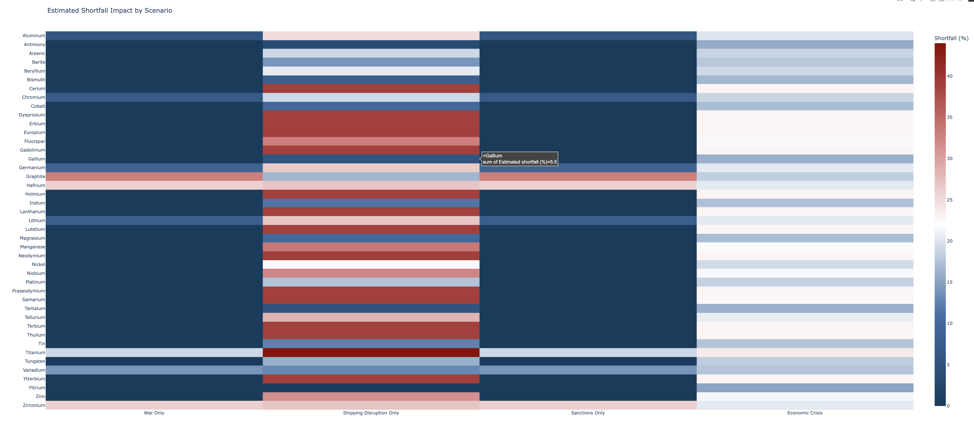
Under the war-only and sanctions-only scenarios, most minerals show relatively low shortfall estimates, indicating that direct geopolitical conflict or targeted sanctions alone may not uniformly disrupt supply across all minerals.
In contrast, the shipping disruption-only scenario produces the most severe and widespread impacts. Many minerals show substantially higher shortfall percentages, suggesting that logistical chokepoints and transportation interruptions pose a greater systemic risk to mineral availability than geopolitical actions alone. This underscores the vulnerability of globalized supply chains to non-military disruptions such as port closures, canal blockages, or maritime instability.
The economic crisis scenario shows more moderate but broadly distributed impacts across minerals. While shortfalls are generally lower than those under shipping disruptions, they are more evenly spread, indicating that demand shocks, financial constraints, and reduced production capacity can affect a wide range of minerals simultaneously.

Slide 7
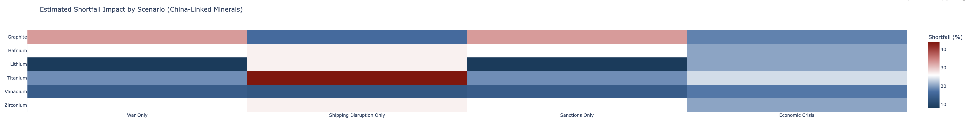
China-linked exposure - A small subset of minerals drives most shortfall risk, rather than broad-based disruption across all minerals.
- Shipping disruptions: Create the largest shortfalls for China-linked minerals, especially titanium and graphite, underscoring reliance on logistics and trade routes.
- War and sanctions: Generally lower impacts, suggesting indirect exposure rather than immediate cutoff for most China-linked supplies.
- Economic crisis: Produces moderate, consistent stress across minerals, reflecting demand and production sensitivity rather than geopolitical leverage.

Slide 8
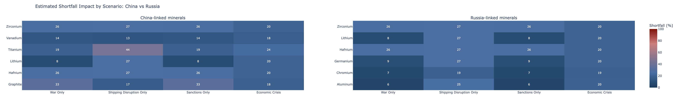
Both China and Russia are strategically contentious from a U.S. foreign-policy perspective, but their roles in critical mineral supply chains are fundamentally different.
- China-linked minerals: Exhibit broader and more variable shortfall risk across scenarios, reflecting China’s central position in global mining, processing, and logistics networks.
- Russia-linked minerals: Show narrower and more consistent impacts, indicating concentrated exposure in fewer minerals rather than system-wide dependency.
- While both countries present geopolitical risk, U.S. mineral supply vulnerability is not equivalent; China poses a more systemic supply-chain risk, whereas Russia’s impact is more limited and mineral-specific.

Slide 9
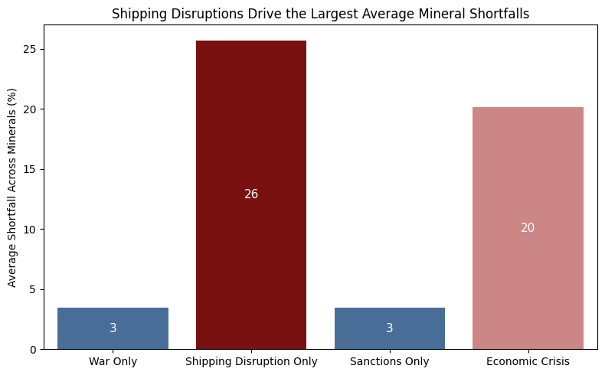
KEY TAKEAWAYS
- Logistics dominate risk: Shipping disruptions generate the largest and most widespread shortfalls across minerals.
- Concentration matters: Many minerals remain vulnerable due to single-supplier dependence, even when sourced from allies.

Slide 10
Appendix
Data Sources
https://www.energy.gov/cmm/what-are-critical-materials-and-critical-minerals
https://www.usgs.gov/centers/national-minerals-information-center/titanium-statistics-and-information
https://www.usgs.gov/news/national-news-release/us-geological-survey-releases-2022-list-critical-minerals
https://pubs.usgs.gov/periodicals/mcs2022/

